Slide 1

Slide Deck 14
ECE 4203 VLSI Design

Slide 2
Outline
Packaging
Power Distribution
Clock Distribution

Slide 3
Packages
Package functions
Electrical connection of signals and power from chip to board
Little delay or distortion
Mechanical connection of chip to board
Removes heat produced on chip
Protects chip from mechanical damage
Compatible with thermal expansion
Inexpensive to manufacture and test

Slide 4
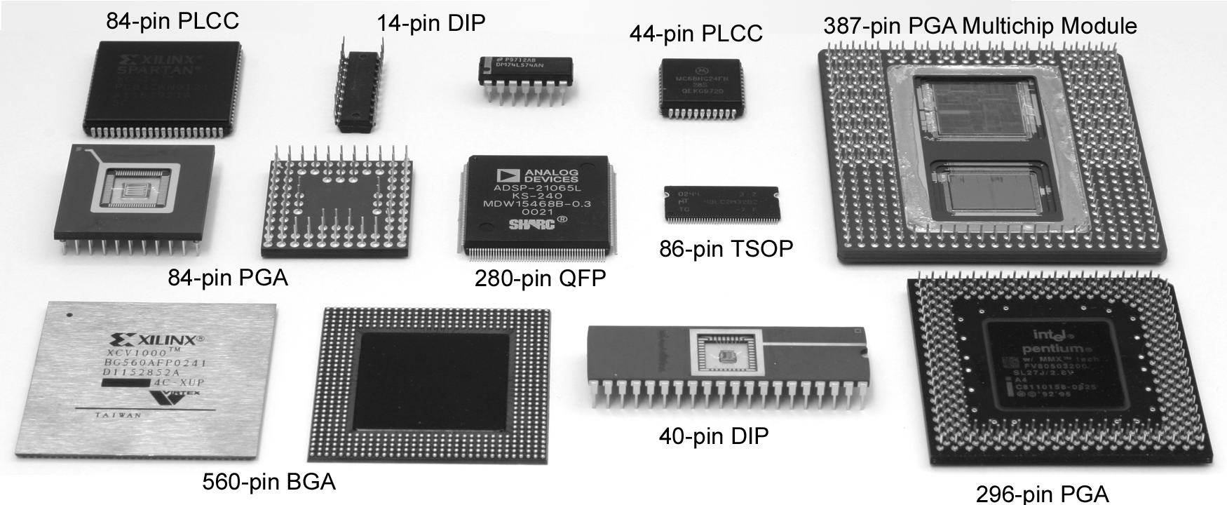
Package Types
Through-hole vs. surface mount

Slide 5
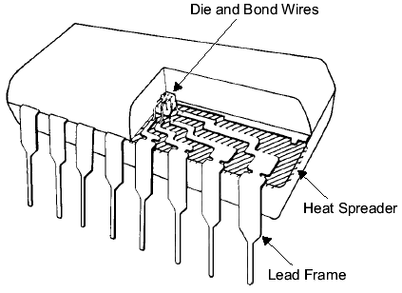
Chip-to-Package Bonding
Traditionally, chip is surrounded by pad frame
Metal pads on 100 – 200 mm pitch
Gold bond wires attach pads to package
Lead frame distributes signals in package
Metal heat spreader helps with cooling

Slide 6
Advanced Packages
Bond wires contribute parasitic inductance
Fancy packages have many signal, power layers
Like tiny printed circuit boards
Flip-chip places connections across surface of die rather than around periphery
Top level metal pads covered with solder balls
Chip flips upside down
Carefully aligned to package (done blind!)
Heated to melt balls
Also called C4 (Controlled Collapse Chip Connection)

Slide 7
Package Parasitics
Use many V_{DD}, GND in parallel
Inductance, I_{DD}

Slide 8
Heat Dissipation
60 W light bulb has surface area of 120 cm²
Itanium 2 die dissipates 130 W over 4 cm²
Chips have enormous power densities
Cooling is a serious challenge
Package spreads heat to larger surface area
Heat sinks may increase surface area further
Fans increase airflow rate over surface area
Liquid cooling used in extreme cases ($$$)

Slide 9
Thermal Resistance
ΔT = θ_{ja}P
ΔT: temperature rise on chip
θ_{ja}: thermal resistance of chip junction to ambient
P: power dissipation on chip
Thermal resistances combine like resistors
Series and parallel
θ_{ja} = θ_{jp} + θ_{pa}
Series combination

Slide 10
Example
Your chip has a heat sink with a thermal resistance to the package of 4.0° C/W.
The resistance from chip to package is 1° C/W.
The system box ambient temperature may reach
55° C.
The chip temperature must not exceed 100° C.
What is the maximum chip power dissipation?
(100-55 C) / (4 + 1 C/W) = 9 W

Slide 11
Temperature Sensor
Monitor die temperature and throttle performance if it gets too hot
Use a pair of pnp bipolar transistors
Vertical pnp available in CMOS
Voltage difference is proportional to absolute temp
Measure with on-chip A/D converter

Slide 12
Power Distribution
Power Distribution Network functions
Carry current from pads to transistors on chip
Maintain stable voltage with low noise
Provide average and peak power demands
Provide current return paths for signals
Avoid electromigration & self-heating wearout
Consume little chip area and wire
Easy to lay out

Slide 13
Power Requirements
V_{DD} = V_{DDnominal} – V_{droop}
Want V_{droop} < +/- 10% of V_{DD}
Sources of V_{droop}
IR drops
L di/dt noise
I_{DD} changes on many time scales

Slide 14
IR Drop
A chip draws 24 W from a 1.2 V supply. The power supply impedance is 5 mΩ. What is the IR drop?
I_{DD} = 24 W / 1.2 V = 20 A
IR drop = (20 A)(5 mΩ) = 100 mV

Slide 15
L di/dt Noise
A 1.2 V chip switches from an idle mode consuming 5W to a full-power mode consuming 53 W. The transition takes 10 clock cycles at 1 GHz. The supply inductance is 0.1 nH. What is the L di/dt droop?
ΔI = (53 W – 5 W)/(1.2 V) = 40 A
Δt = 10 cycles * (1 ns / cycle) = 10 ns
L di/dt droop = (0.1 nH) * (40 A / 10 ns) = 0.4 V

Slide 16
Bypass Capacitors
Need low supply impedance at all frequencies
Ideal capacitors have impedance decreasing with w
Real capacitors have parasitic R and L
Leads to resonant frequency of capacitor

Slide 17
Power System Model
Power comes from regulator on system board
Board and package add parasitic R and L
Bypass capacitors help stabilize supply voltage
But capacitors also have parasitic R and L
Simulate system for time and frequency responses

Slide 18
Frequency Response
Multiple capacitors in parallel
Large capacitor near regulator has low impedance at low frequencies
But also has a low self-resonant frequency
Small capacitors near chip and on chip have low impedance at high frequencies
Choose caps to get low impedance at all frequencies

Slide 19
Example: Pentium 4
Power supply impedance for Pentium 4
Spike near 100 MHz caused by package L
Step response to sudden supply current chain
1st droop: on-chip bypass caps
2nd droop: package capacitance
3rd droop: board capacitance
[Xu08]
[Wong06]

Slide 20
Charge Pumps
Sometimes a different supply voltage is needed but little current is required
20 V for Flash memory programming
Negative body bias for leakage control during sleep
Generate the voltage on-chip with a charge pump

Slide 21
Energy Scavenging
Ultra-low power systems can scavenge their energy from the environment rather than needing batteries
Solar calculator (solar cells)
RFID tags (antenna)
Tire pressure monitors powered by vibrational energy of tires (piezoelectric generator)
Thin film microbatteries deposited on the chip can store energy for times of peak demand

Slide 22
Clock Distribution
On a small chip, the clock distribution network is just a wire
And possibly an inverter for clkb
On practical chips, the RC delay of the wire resistance and gate load is very long
Variations in this delay cause clock to get to different elements at different times
This is called clock skew
Most chips use repeaters to buffer the clock and equalize the delay
Reduces but doesn’t eliminate skew

Slide 23
Example
Skew comes from differences in gate and wire delay
With right buffer sizing, clk₁ and clk₂ could ideally arrive at the same time.
But power supply noise changes buffer delays
clk₂ and clk₃ will always see RC skew

Slide 24
Review: Skew Impact
Ideally full cycle is
available for work
Skew adds sequencing
overhead
Increases hold time too

Slide 25
Solutions
Reduce clock skew
Careful clock distribution network design
Plenty of metal wiring resources
Analyze clock skew
Only budget actual, not worst case skews
Local vs. global skew budgets
Tolerate clock skew
Choose circuit structures insensitive to skew

Slide 26
Clock Dist. Networks
Ad hoc
Grids
H-tree
Hybrid

Slide 27
Clock Grids
Use grid on two or more levels to carry clock
Make wires wide to reduce RC delay
Ensures low skew between nearby points
But possibly large skew across die

Slide 28
Alpha Clock Grids

Slide 29
H-Trees
Fractal structure
Gets clock arbitrarily close to any point
Matched delay along all paths
Delay variations cause skew
A and B might see big skew

Slide 30
Itanium 2 H-Tree
Four levels of buffering:
Primary driver
Repeater
Second-level
clock buffer
Gater
Route around
obstructions

Slide 31
Hybrid Networks
Use H-tree to distribute clock to many points
Tie these points together with a grid
Ex: IBM Power4, PowerPC
H-tree drives 16-64 sector buffers
Buffers drive total of 1024 points
All points shorted together with grid

